Slide 1
Bethlehem
It’s significance in God’s plan

Slide 2
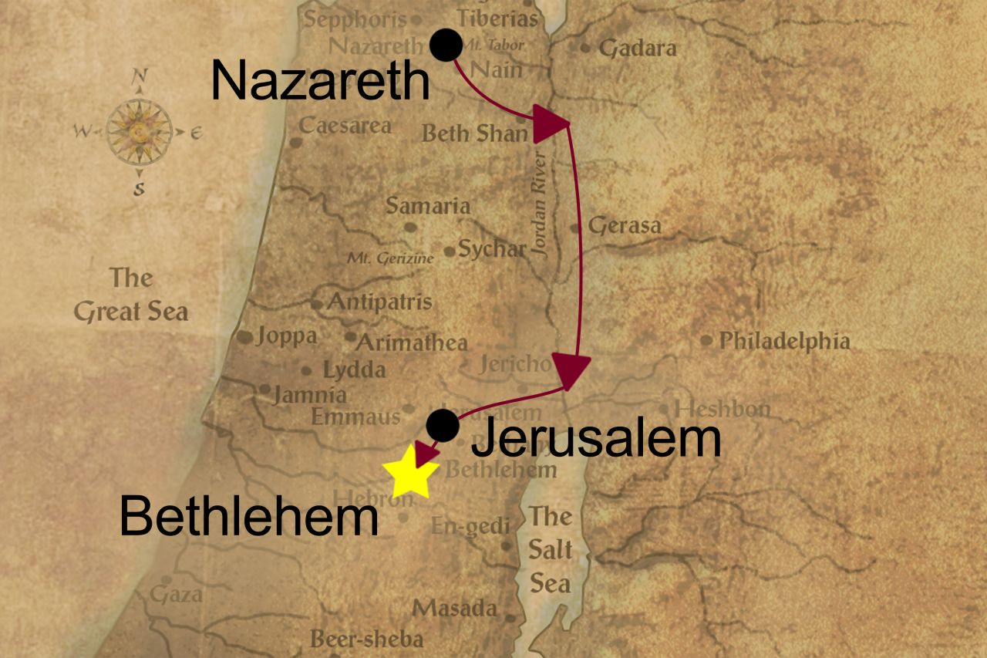
A picture is worth a thousand words

Slide 3
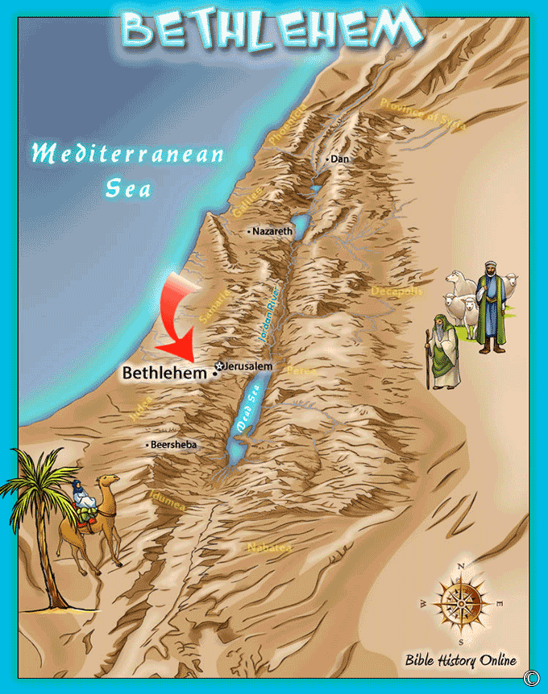
And another

Slide 4
The first Reference
Genesis 35:19
Rachel buried near there, but Rachel died in child birth
So birth and death associated with Bethlehem
Luke 2- swaddling cloths

Slide 5
Ruth 1
Ruth’s father and mother-in-law (Naomi) were from Bethlehem
Bethlehem-Moab-Bethlehem
Boaz
Redemption

Slide 6
David
1 Samuel 16:1
Ruth’s grandson Jesse (David’s dad) raised his family there
David tended his father’s sheep there (1 Samuel 17:15) and was anointed by Samuel as king in Bethlehem (shepherds outside of Bethlehem ring a bell?)
Bethlehem was the city of David

Slide 7
Anyone thirsty?
2 Samuel 23:14

Slide 8
Most familiar reference
Micah 5:2-4

